Slide 1
Types of search
Table Scan : when Index is not there ,It does linear serach where search for each and every record.
Index Unique Sequence: unique index does NOT allow duplicate values for the indexed column inside table also in B-tree or index on primary Key.
So when we search on this unique index with where clause called Unique Scan
Note: (i)When we create Primary Key, Clustered Index is automatically created if no cluster index is present
(ii) If cluster Index is already Present then it will create Non-cluster Index

Slide 2
Range Index Scan: where condition has equality or range predicate
<=,>=,<,>,between.
Example: select id ,name from student wher marks>20
If index is available on marks then it’s a range scan other wise full scan
Because If we create index on marks then B-tree create in the basis of marks(keys) and it will search on specific range

Slide 3
Indexing
Indexing are Used By query to fetch data from Table Quicky.
Reduce Time to fetch Data easily
If you don’t use index , It will be a full table Scan so Its time to fetch data of we have an Millions of Record
Without index: Select * from EMPLOYEE
WHERE SALARY>7000, & SALARY <10000.
The above query include a Full Table Scan

Slide 4
Create an Index:
Create index emp_index Employee(SALARY ASC)
=> Now salary is the index key
By default Index key values is in ascending Order
Above table is index table . Above table is Employee(Original Table) Table
SALARY | Row address
2500 | ptr1
3100 | ptr2
4500 | ptr3
5500 | ptr4
ID | NAME | SALARY | GENDER
1 | SAMARTH | 2500 | MALE
2 | AKASH | 5500 | FEMALE
3 | JOHN | 4500 | MALE
4 | SARA | 3100 | FEMALE

Slide 5
In index table You can see that Index Store Salary of each Employee in ascending Order, But in original table you can see that salary is
not in sorted order because id attribute(pk) in Employee(Original Table) is an unique cluster index.(will explain letter)
Now we execute query
Select * from EMPLOYEE
WHERE SALARY>7000 & SALARY <10000.
So there is no full table scan It use binary Search to search the salary column(node) in Index Table where SALARY>7000 & SALARY <10000
When particular column or node is found in index Table by the help of pointer we can fetch all the attributes data available in Employee table(Original Table).

Slide 6
(Q) How can you find the total Number of Index Present in a Table
Ans: exec sp_helpindex Table_Name
(Q) How to drop Index
Ans: drop Index Index_Name On Table_Name

Slide 7
Type of Index
Cluster Index : Itis an Index that determine the Physical Order of data in a table or you can also say that Cluster Index determine the Structure of Data Store in Hard disk
If we have a Primary Key in table So unique Cluster index is automatically Created .
A table can have only one cluster Index
By default Cluster Index is in ascending Order now it’s your choice you can use ASC OR DESC
if you need to Create a cluster index
Syntax : CREATE Clustered Index Index_Name Table_Name(Attribute or column_name)

Slide 8
Note (i) For create a new cluster index in table delete a previous cluster index. Because a table can have only one cluster index. (ii) clustered index can allow duplicate value in index column but unique non clustered or unique cluster index can not allowed duplicate values
Suppose we write Query :
Insert into Employees values(2,’AKASH’,5500,’FEMALE’)
Insert into employee values (1,’SAMARTH’,2500,’MALE’)
You are adding data in Random Order but in original table but you see that id is in sorted order by default because id is a cluster index
ID(pk) | NAME | SALARY | GENDER
1 | SAMARTH | 2500 | MALE
2 | AKASH | 5500 | FEMALE

Slide 9
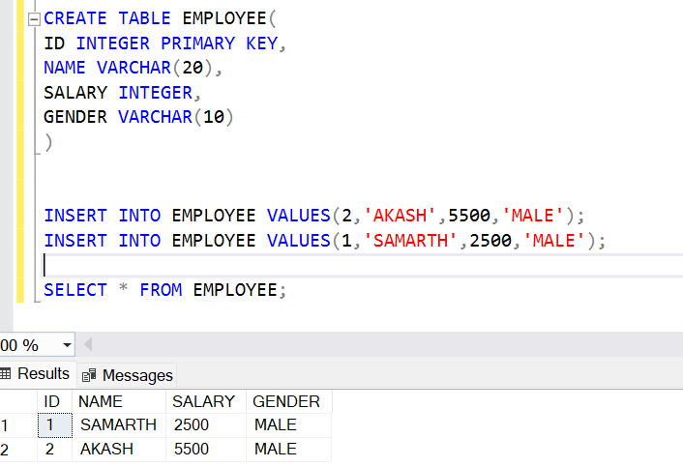

Slide 10
(ii) NON CLUSTERED INDEX or B-tree Index
Create NONCLUSTERED index emp_index Employee(SALARY ASC)
Now salary is the index key
There can be more than one non Clustered Index in a table
By default Index key values is in ascending Order
Above table is index table . Above table is Employee(Orignal Table) Table
SALARY | Row address
2500 | ptr1
3100 | ptr2
4500 | ptr3
5500 | ptr4
ID | NAME | SALARY | GENDER
1 | SAMARTH | 2500 | MALE
2 | AKASH | 5500 | FEMALE
3 | JOHN | 4500 | MALE
4 | SARA | 3100 | FEMALE

Slide 11
In index table You can see that Index Store Salary of each Employee in ascending Order, But in original table you can see that salary is
not in sorted order because id attribute in Employee(Original Table) is an unique cluster index.(will explain letter)
Now we execute query
Select * from EMPLOYEE
WHERE SALARY>7000 & SALARY <10000.
So there is no full table scan It use binary Search to search the salary column(node) in Index Table where SALARY>7000 & SALARY <10000
When particular column or node is found in index Table by the help of pointer we can fetch all the attributes data avaible in Employee table(Original Table).

Slide 12
Unique Index:
A unique index does not allow duplicate values in the indexed column(s).
There can be more than 1 unique index in a table
There can be more than 1 unique non clustered index in a table
There can be only 1 unique clustered index in a table means
NOTE: Unique and unique non clustered index are same because by default it’s a non clustered index or B-Tree index

Slide 13
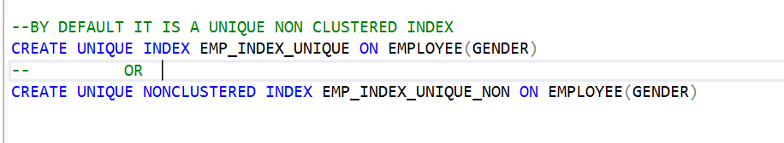
Unique clustered index

Slide 14
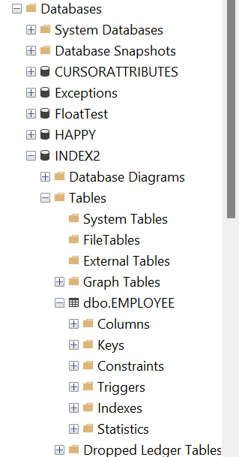
EXTRA INFORMATION

Slide 15
Composite Index
Same for B-tree and allowed Duplicates
Can be multiple unique index in same table.
Example :CREATE INDEX idx_customer_name_age
ON Customers (FirstName, LastName ,Age);
Inside arraylist of Node , node contains 2 keys (FirstName, LastName,age ) and next_ptr
B-tree:->
(shalabh,bhatiya,21)

